Slide 1
Establishment
of a Business
Enterprise
Copyright © 2004 Pearson Education, Inc.
Slide 6-<number>

Slide 2
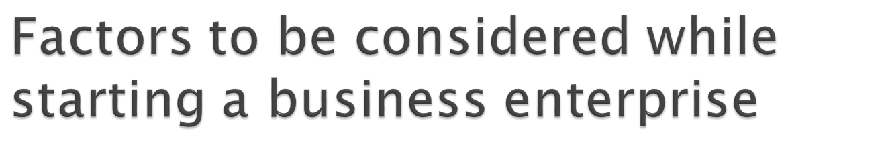
Identification of Business opportunity
Market Assessment
Suppliers
Technology
Location
HR
Finance

Slide 3


The process by which an opportunity is identified is described as opportunity scanning and identification(OSI)
An important tool in identification of an business opportunity is the SWOT analysis .SWOT analysis means analysis of our strength & weakness in relation to opportunities in the market and competitive threats to the same
An entrepreneur would evaluate an opportunity somewhat as follows
What is the status of Industry in the economy ?
Present production
Present demand
Government policies
Export Potential

Slide 4
How large is the gap between demand and supply in the market?
What is the nature of competition in the market for the product?
Is the product covered under any promotional policies of the government so that either entry into business or competition in the market are facilitated?
Are there any special products /service specific problems that he will face and can avail of any part of promotional policies to soften the impact of these problems?
Based on all such analysis he will finally conclude that the opportunity is worth investing in .

Slide 5

Make an honest evaluation of yourself and your abilities.
Legal and Financial representation is important
Make a market evaluation of the product or service to be offered.
Find out how many buyers have been in the business successfully for a respectable period of time.
Check the training and experience required to run the business properly.
Is there financial strength and strong credit behind the business opportunity?

Slide 6
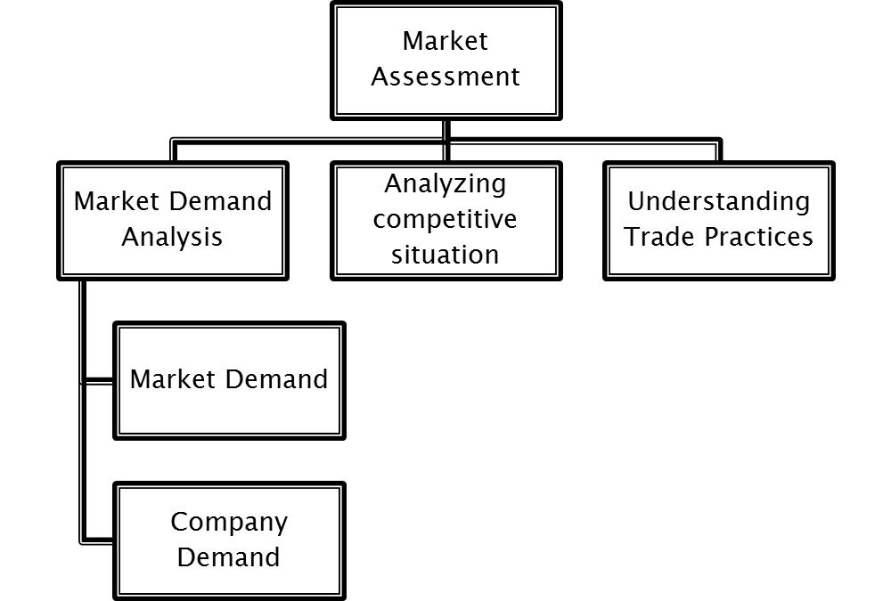

Slide 7
Market Demand Analysis
Market Demand :Market demand for a product is the total volume that would be bought by a defined customer group in a defined geographical area in a defined time period in a defined marketing environment under a defined marketing programme.
Company demand :It is the company’s share of market demand
The exercise of market demand analysis will provide answers to many questions such as
Who would buy the product
Why would they Buy it
How many would buy it

Slide 8
Analysing competitive situation
In order to assess and understand the competitive situation ,an entrepreneur should try to answer the following questions:
How many firms are in competition with him
What are their market share
What are the Strengths & weakness of their products
What kind of consumer image does each product enjoy
What trade practices do the competitors employ
Who are the major Customers of each brand
Correct understanding of the nature & extent of competition is essential as the whole process of marketing planning revolves around this understanding

Slide 9
Understanding Trade Practices
Whether it has to reach the ultimate customers directly or through intermediaries (i.e. :marketing middlemen like Distribution ,wholesalers ,retailer ,commission agents ,brokers)
If the middlemen are to be employed what kind of middlemen are required
How many middlemen are required
Places where middlemen are required
How much selling load taken by each middlemen
How much trade discounts are required to be offered
How much cash discount are required to be offered
What kind of gift scheme is to be offered for middlemen & ultimate customer
How much credit period to be allowed
What are the prevailing sales tax & legal implication in selling to the middlemen situated in different Location
What are available modes of transportation to reach them

Slide 10
Check availability of raw material
Raw material for making the product should be readily available. Import of the material should be avoided because this will make it difficult to ensure a steady supply.
A number of suppliers should be identified.
It is important to avoid reliance on a single supplier as this will give the supplier a monopoly and is most likely to lead to an increase in prices over time. Because the profit margin in a micro-enterprise is generally small, it is necessary to keep production costs under close control. It is important to ensure constant quality.
Alternative sources of raw material may also be considered such as forest products that are readily available and free of charge. Recycling and re-use is another way of reducing costs.
The steady availability of water is another important consideration while selecting the enterprise and identifying the raw material. This is especially important for farming activities.

Slide 11
This is another influencing factor in selection criteria of the project.
The projects should be located close to human resources and material availability.
A new entrepreneur should locate his project in and around the state headquarters.
The project should be located in such a place where entrepreneurs can attract competent managers.
It should have transportation facility & communication links

Slide 12
Location plays a crucial role in starting a small-scale enterprise. The micro-entrepreneur will have to travel to the market to sell the product. When the business involves fresh produce, timely sale is crucial. For example, fruits, vegetables and flowers are highly perishable and have to be sold quickly. Easy access to markets is important.
In the case of services, micro-enterprise location should encourage people from the village to come to the entrepreneur's workplace, which must be easily accessible to clients, and be somewhat attractive. Low-cost decorations can be used to attract clients while good service will ensure their return.

Slide 13
Land and premises
Land and premises are needed for the establishment of any enterprise. In case these have to be acquired, the start-up costs will increase. If the new micro-entrepreneur already owns these, he or she may have to spend on renovation. The following questions should serve as guidelines:
1. How much space do I need?
2. Do I have a piece of land or building I can use?
3. What will be the cost of the land?
4. Do I need to rent the premises?
5. Does a new building need to be built?
6. Can the existing building (s) be renovated?
7. Do I need decoration? (Decoration may be needed to attract customers.)

Slide 14
Technology is the process of converting inputs (Ie :raw material ,labor) into outputs .the various factors for evaluating production process & equipment selection are as follows
What are product /service requirements
What is technology feasibility
Financial considerations
What are the labor & skill requirements
What capacity Is to be installed
Are new facilities compatible with existing facilities
Are new facilities flexible
What are raw material requirements
What is the size & weight limits imposed by plant or building
What kind of maintenance is required
What are the spare parts inventory requirements

Slide 15

Technology has had a huge impact on the business world. Today’s business world is nothing like it was before the effects of technology took it over.
Computers alone have had a huge effect on the business world. Employee’s work has been made easier by the use of such things as Microsoft’s Word and Excel.
Add the internet for making it easier to contact customers and vendors.
Business deals are even discussed through technology like face to face conversation.
Computers are the one piece of technology that has made the biggest impact on the business world.

Slide 16

Use Of Technology
What kind of Technology to be used
Adoption and Diffusion

Slide 17
The exercise of manpower analysis will answer to many questions such as
What are the requirements of a skilled ,semi skilled personnel for production operations for the first year ,second year up to first 10 years of project life
What are the requirements of the administrative /managerial staff & marketing personnel
What is the cost of manpower during first year ,second year & so on for 10 years
What is the position regarding the availability of skilled manpower

Slide 18
Finance is the set of activities dealing with the management of funds. More specifically, it is the decision of collection and use of funds.
Finance is also the science and art of determining if the funds of an organization are being used properly.
The capital requirement of a business are of two types, (a) fixed capital; and (b) working capital.
Fixed capital refers to funds required for acquiring fixed assets like land, building, machinery and equipments, whereas working capital is required to meet the routine expenditure like payment of salary, wages, electricity and telephone bill, purchase of raw materials, payment for transport, etc.

Slide 19

Where can we raise the capital
What will be the return
What will be the sources of finance
What will be the promoters contribution

Slide 20
A small business is a business that is independently owned and operated, with a small number of employees and relatively low volume of sales.
There is no specific criteria to differentiate between small and big business
However 2 standard have been used to define Small Scale business
Size of the business : is often defined in terms of size. All firms which have not grown beyond a certain size are classified as small.
The criteria used the measure the size of small business are :
the number of persons employed
the amount of capital invested
The value of annual sales the turnover
Qualitative Criteria: Size is not a very good criterion of small business because the employment & investment vary widely with the nature of industry .Complexity of management may be a better measure

Slide 21
Small business may be defined in various ways eg: in terms of investment ,number of persons employed ,volume of output & sales ,technique of production etc .
However in India ,small business is defined by the government ,as consisting of the following four types of Businesses:
Small scale Industries:
Ancillary Industrial undertaking:
Export –Oriented units:
Tiny Units:
Women Enterprise:

Slide 22
Small scale Industries: The investment in plant & machinery is up to Rs 1 Crore . These include manufacturing and service units.
Ancillary Industrial undertaking: The investment in plant & machinery not to exceed Rs 1 Crore.
An industrial undertaking which is engaged or is proposed to be engaged in the manufacture or producing of parts, components, sub-assemblies, tooling or intermediates; or the rendering of services is termed as an ancillary undertaking.

Slide 23
Export –Oriented units: the investment in plant and machinery is up to Rs 5 crore & the unit must export at least 30% of its outputs by the end of three years from the commencement of production
Tiny Units: A unit is treated as a tiny enterprise where the investment in plant and machinery does not exceed Rs. 25 Lakhs irrespective of the location of the unit. Many shops, schools, parlours, Photostat and STD booths in your vicinity are all examples of tiny units
Women Enterprise: is operated by one or more women entrepreneur or if there is women proprietorship or if women have individually or jointly not less that 51% capital investment as partners or shareholders .

Slide 24
Limited Investment: Capital is supplied & ownership is in the hands of one individual or a small group of individuals .Proprietary form of ownership is dominant in small scale sector
Personal management & organization :Management is independent & personalized i.e Mangers are usually the owners of the business . There is an element of personal Touch
Area of Operations: The area of operations is mainly local through the goods might be exported .Owners & workers are generally from one state or region
Notes:
.

Slide 25
Simple Technology: Small enterprises are generally labour intensive. The machinery & equipment used are not very sophisticated & they are generally operated manually .Amount of working capital is generally bigger than fixed capital indicating their labour intensity. Labour is the primary input
Employment: Small scale industries are an important source for generating employment .In a country like India ,where unemployment is the root cause of many social evils ,small scale business units are of immense help.

Slide 26
Employment :To create immediate employment opportunities with relatively Low investment
To make small industries export –Oriented & help quality up gradation
Regional disparities :To remove regional disparities through a deliberate policy
Encourage growth in the villages & small towns
To reduce disparities in income ,wealth & consumption
To mobilize resource of capital & skills & their optimum utilization
To eliminate economic backwardness of rural & underdeveloped regions in the country
To provide steady source of income to the low-income groups living in rural & urban areas of country
To improve the quality of industrial products manufactured in the cottage industry sector & to enhance both production & exports
To attain self reliance

Slide 27
Shortage of material & power
Lack of adequate finance
Out dated Technology
Inadequate marketing facilities
Weak Organization & management
Lack of Trainer personnel
Inadequate infrastructure

Slide 28
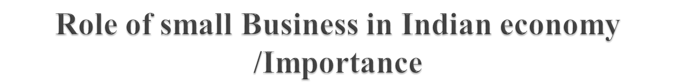
Employment
Balanced Regional Development
Small Capitals & quick return
Use of latent resources of the community
Equitable distribution of wealth
Complementary to large scale Industries
Potential of earning foreign exchange
Facilitate entrepreneurial development

Slide 29
A trade association may be defined as “a organization for mutual protection or advantage of independent enterprises producing or distributing similar goods & services “
It is an organization formed to promote the mutual interests of individuals or companies engaged in the same kind of business
Also defined as a non –profit voluntary organization of business competitors operating in the same line of business for the promotion of their common economic interests
It tries to serve as an instrument by which abusive ,unfair & unethical practices in the trade can be eliminated For this purpose ,many associations adopt codes of ethics to be followed by their members .

Slide 30
“Any combination, whether temporary or permanent, formed primarily for the purpose of regulating the relations between workmen and employers, or between workmen and workmen, or between employers and employers, or for imposing restrictive conditions on the conduct of any trade or business, and includes any federation of two or more trade unions.”
Then this definition talks about three relationships. They are relationship between the:
Workmen and workmen
Workmen and employers
Employers and employers.

Slide 31

It is an organisation formed by employees or workers.
It is formed on a continuous basis. It is a permanent body and not a casual or temporary one.
It is formed to protect and promote all kinds of interests –economic, political and social-of its members. The dominant interest with which a union is concerned is, however, economic.
It includes federations of trade unions also.
It achieves its objectives through collective action and group effort

Slide 32
To improve the economic lot of employees by securing for them better wages.
To secure better working conditions for the workers.
To secure bonus for the employees from the profit of the concern,
To resist schemes of the management which reduce employment, e.g., rationalisation and automation.
To secure welfare of employees through group schemes which give benefit to every employee.
To protect the interests of employees by taking active participation in the management.
To secure social welfare of the employees.
To secure organisational stability, growth, and leadership.

Slide 33

Broadly speaking, trade unions perform two types of functions, viz.,
Militant Functions. One set of activities performed by trade unions leads to the betterment of the position of their members in relation to their employment. The aim of such activities is to ensure adequate wages, secure better conditions of work and employment, get better treatment from employers, etc. When the unions fail to accomplish these aims by the method of collective bargaining and negotiations, they adopt an approach and put up a fight with the management in the form of so-slow, strike, boycott, gherao, etc. Hence, these functions of the trade unions are known as militant or fighting functions.

Slide 34
Fraternal Functions. Another set of activities performed by trade unions aims at rendering help to its members in times of need, and improving their efficiency. Trade unions try to foster a spirit of cooperation and promote friendly relations and diffuse education and culture among their members. They also arrange for legal assistance to its members, if necessary. Besides, these, they undertake many welfare measures for their members, e.g., school for the education of children, library, reading-rooms, in-door and out-door games, and other recreational facilities. Some trade unions even undertake publication of some magazine or journal. These activities, which may be called fraternal functions, depend on the availability of funds, which the unions raise by subscription from members and donations from outsiders, and also on their competent and enlightened leadership.

Slide 35
Lack of education makes the workers narrow-minded, and prevents them from taking long-term views. Thus, anything, which does not result in an immediate reward, becomes unattractive to them. This attitude is responsible for many strikes and lock-outs in industrial concerns.
Trade unions may not welcome rationalization and improved methods of production for the fear that some of the workers will be put out of work. Therefore, they resort to go slow policy that retards industrial progress.

Slide 36
When labor unions strike because of illogical grounds, incalculable losses occur to producers, community and the nation. These are harmful to the workers also. They suffer because of the loss of wages.
They create artificial scarcity of labor by demanding that only union personnel should be employed.
By undue insistence on the payment of standard rates of wages, they have only leveled down the earnings of the efficient workers.

Slide 37
Another broad classification of the functions of unions may be as follows
Intra-mural activities. These consist of those functions of the unions that lead to the betterment of employment conditions such as ensuring adequate wages and salaries, etc. for which the methods adopted may be collective bargaining, negotiations, strikes, etc.
Extra-mural activities. These activities help the employees to maintain and improve their efficiency or productivity, e.g., measures intended to foster a spirit of cooperation, promote friendly relations, and diffuse education among members and various other types of welfare measures.

Slide 38
Political activities. Modern trade unions also take up political activities to achieve their objectives. Such activities may be related to the formation of a political party or those reflecting an attempt to seek influence on public policy relating to matters connected with the interests of working class.

Slide 39
Plant level Unions: The first level in the structure from below is the plant level union. This comprises the unions in one organisation or factory. Please note that only seven members are required to form a union. This has lead to multiple unions in one factory. (We will discuss the details of this aspect in the problems faced by unions in India).
Local Level federations. This is the second level in the structure from below. The local trade union federation holds together the plant level unions at the local level in a particular craft and industry. These local level federations might be affiliated to either some regional level or national level federation or these may be independent.

Slide 40
Regional level federations. These are the organisations of all the constituent unions in a particular state or region.
National federations. These are national level bodies to which plant level unions, local unions or regional level unions may get affiliated. These are the apex bodies at the top of the structure. They act as coordinating bodies. These national federations may have their own regional or state level coordinating bodies to which the plant level unions may get affiliated.

Slide 41
A chamber of commerce is an association of merchants ,financers ,manufactures & others engaged in business in a particular locality or region for promoting the general commercial interests of their markets .
Chambers of commerce work to protect the interests of their members & foster the growth & development of commerce & industry of the respective regions in which they operate .
They are formed to promote & protect general trade interests all the members ,irrespective of class of trade they engaged in.
Its members seek to promote the interests of business, typically in a broad-based way.
Chambers of commerce exist on state, regional, national, and even international levels.

Slide 42

They strive to develop and publicize business opportunity in their community
They provide information and timely advice on business matters to their members through the large network of business
They provide opportunities for networking
They also provide special events, committees and so on

Slide 43

Main objectives are
To push down business taxes
Improve labor relations
Increase production
Develop new market
Keep organized business strong and increasingly effective

Slide 44

The international Chamber of Commerce functions as a vital mechanism for articulating global business concerns to world opinion leaders and the public at large
Notes:
Court of Arbitration
Law

Slide 45

Their membership is voluntary
They are non-profit organization
They do not run any business of their own
Their activities are financed mainly out of the entrance fees & annual subscription fees collected from members
They do not interfere with the internal administration or the working of the members concerned

Slide 46

Name
Indian Chamber of Commerce
The Associated Chambers of Commerce and Industry of India.
Delhi Chamber of Commerce
Bombay Chamber of Commerce and Industry
Madras Chamber of Commerce & Industry
Calcutta Chamber of Commerce
The Bengal Chamber of Commerce and Industry
Bangalore Chamber of Industry & Commerce
Mahratta Chamber of Commerce Industry & Agriculture
Ramgarh Chamber of Commerce & Industries (Ramgarh Cantt., Jharkhand)
Notes:
List of Chamber of Commerce and Industries in India

Slide 47
Name
All India Iron & Steel Exporters Association
Federation of Indian Export Organisations
Indian Society of Engineers
Kanpur Constructors Association
All India Iron & Steel Exporters Association
CONFEDERATION OF INDIAN INDUSTRY (CII)
SSOCIATED CHAMBERS OF COMMERCE & INDUSTRY OF INDIA (ASSOCHAM)
ASSOCIATION OF MUTUAL FUNDS IN INDIA(AMFI)

